Slide 1
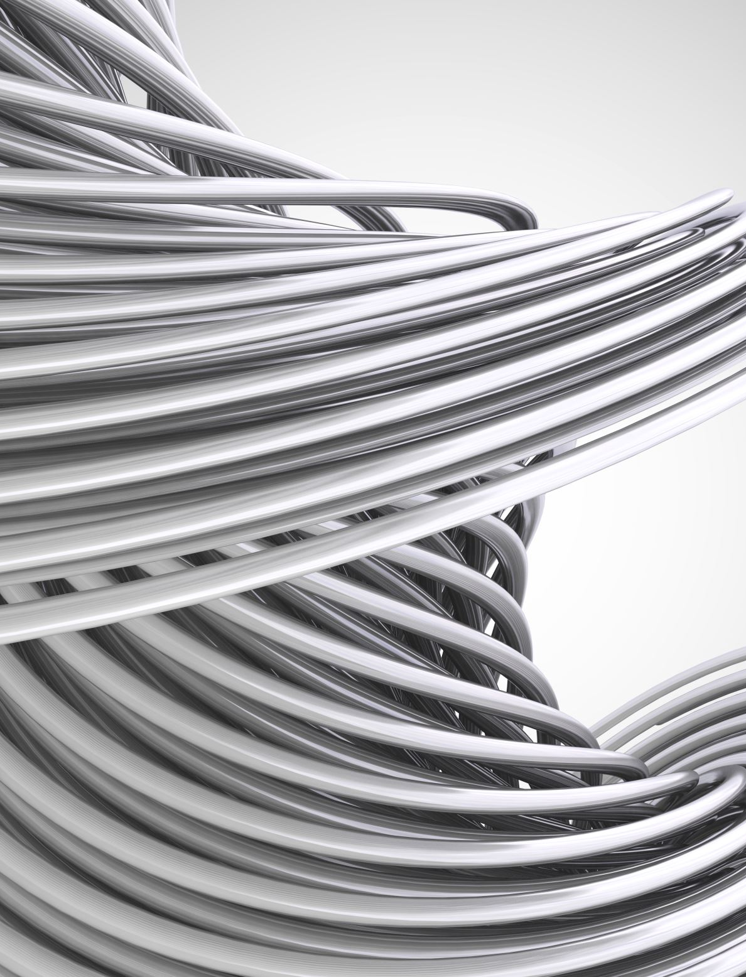
Microstrip patch antenna for breast cancer diagnosis With a frequency of 2.45 GHz and parameter sweep of the antenna dimensions
Candidates: Lecturer: Fabio Fanelli Prof. Marco Grande
Paolo Mazzone

Slide 2
Reference paper «A microstrip patch antenna design for breast cancer detection»
Authors: R. Çalişkan, S. Gültekin, D. Uzer, Ö. Dündar
Whitepaper: Procedia - Social and Behavioral Sciences 195 — 2015
DOI: 10.1016/j.sbspro.2015.06.418

Slide 3
Analysis purposes
The first objective of this work is to validate the main antenna design described in the paper;
Other antenna designs, discussed in the paper, will be analysed and compared in order to find the best to diagnose breast cancer;
To further improve the cancer detection, a parameter sweep will be performed. The patch dimensions will be changed to find the best parameters set;
Another parameter sweep will be performed to test the ability of the antenna to detect smaller cancerous masses.

Slide 4
Antenna parameters
Name | Value [mm] | Description
sub_x | 65.4 | Substrate width
sub_y | 88.99 | Substrate length
sub_thick | 1.588 | Substrate thickness
p_x | 37.26 | Patch width
p_y | 28.83 | Patch length
inset_dist | 9.574 | Inset distance
inset_gap | 1.518 | Inset gap
f_length | 27.958 | Feed length
f_width | 3.036 | Feed width
g_thick | 0.035 | Ground thickness
b_thick | 80 | Normal breast tissue thickness/height
sk_thick | 1 | Skin tissue thickness
c_radius | 20 | Cancer sphere radius

Slide 5
CST modeling of the patch antenna Antenna only, without the breast

Slide 6
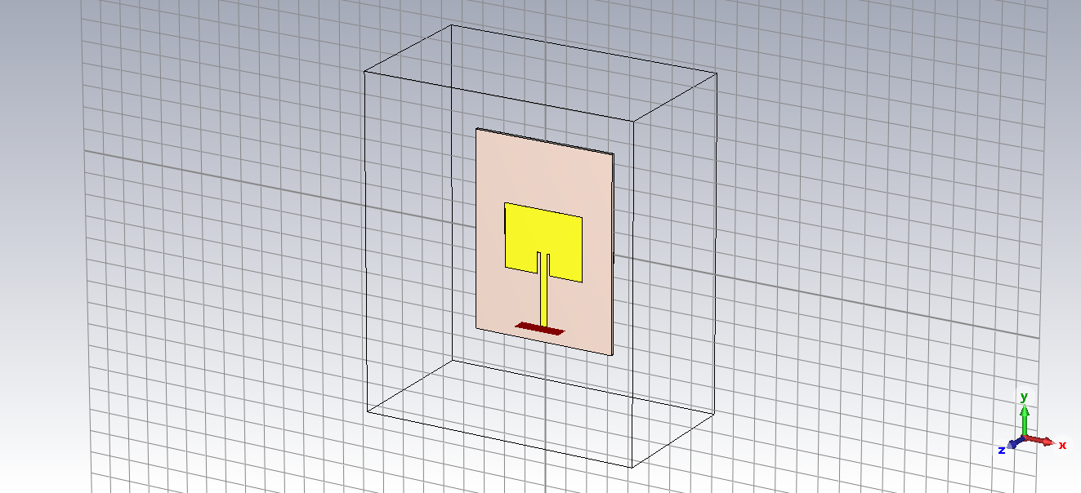
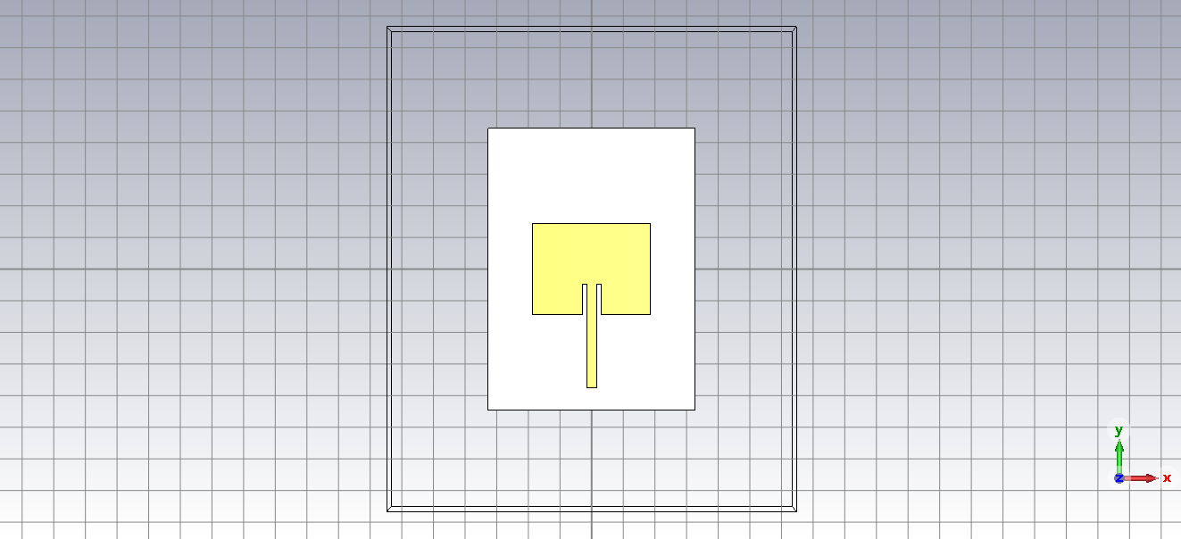
3D representation of the antenna
Perspective view
Front view

Slide 7
Scattering Parameters (S₁₁)

Slide 8
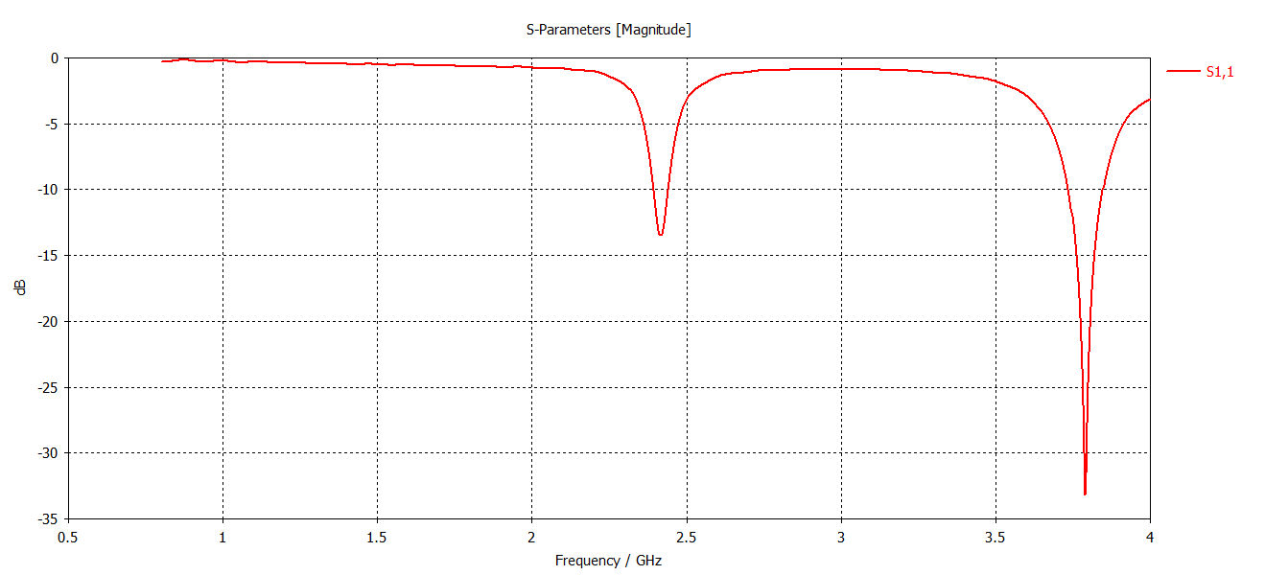
S₁₁ – Antenna only

Slide 9
VSWR (Voltage Standing-Wave Ratio)

Slide 10
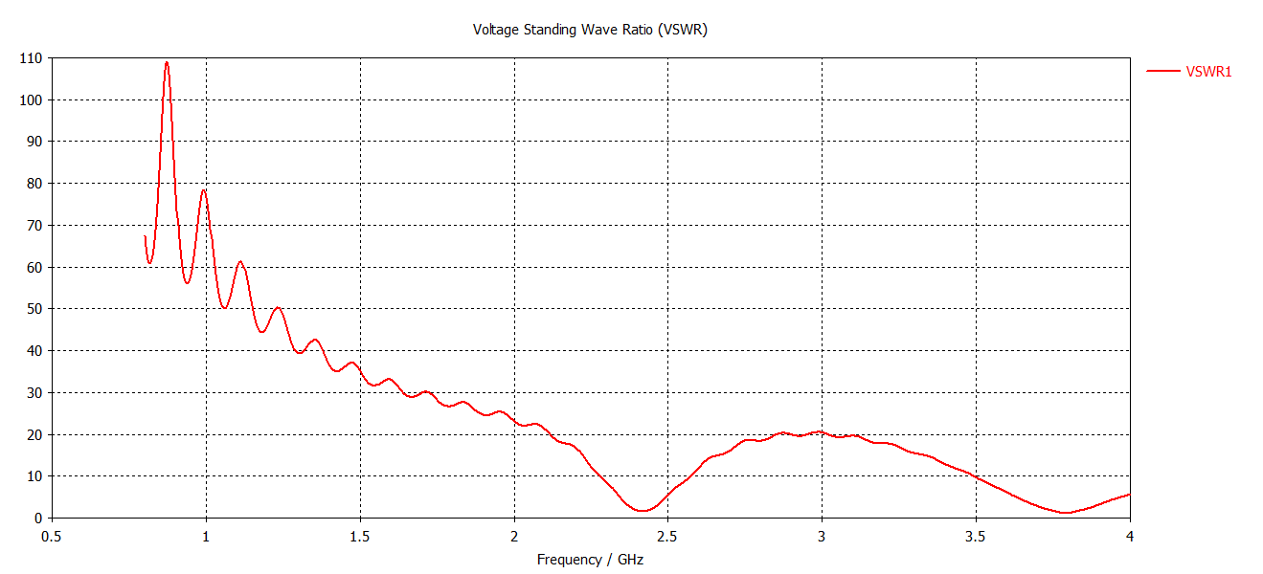
VSWR – Antenna only

Slide 11
Directivity (3-dimensional pattern, Azimuthal plane, Elevation plane)

Slide 12
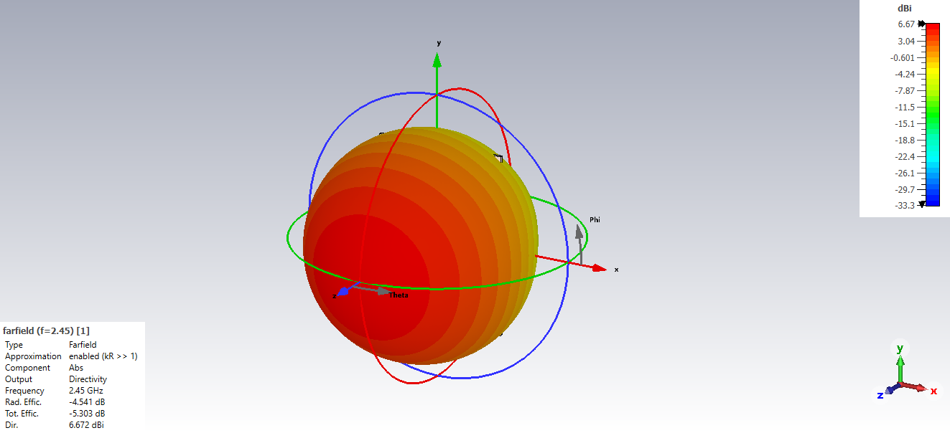
Directivity – Antenna only
3-dimensional representation of the emissions of the antenna

Slide 13
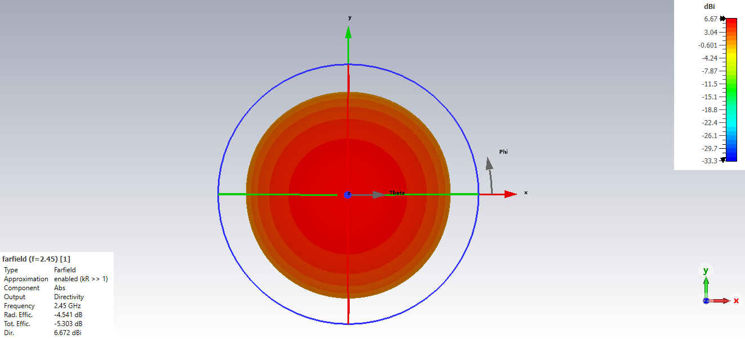
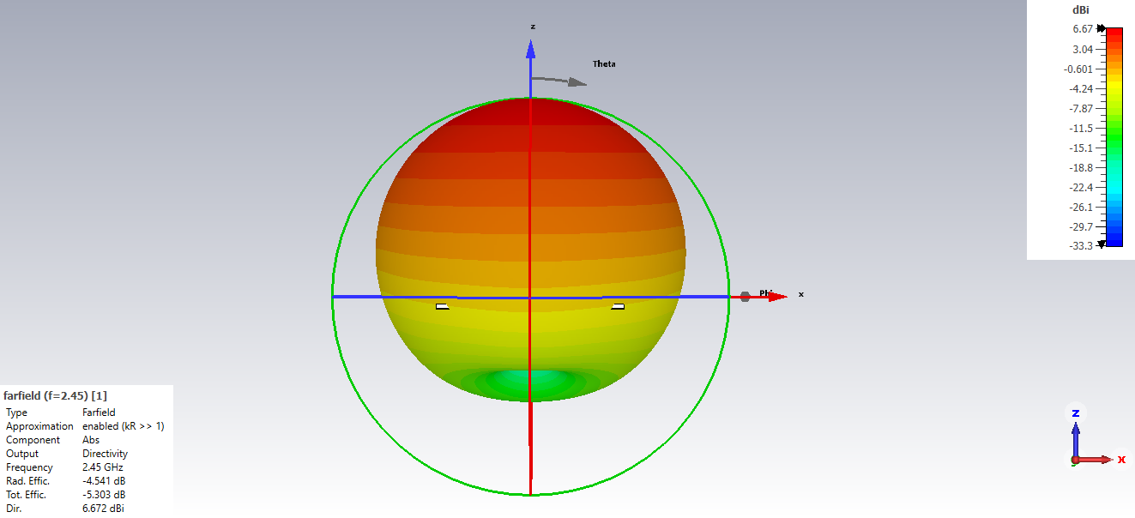
Directivity – Antenna only
Azimuth plane
Elevation plane

Slide 14
Current distribution

Slide 15
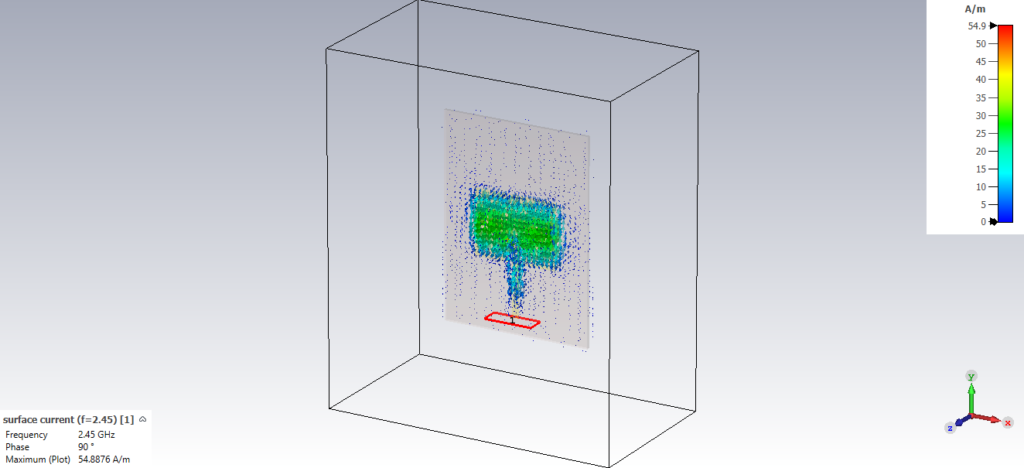
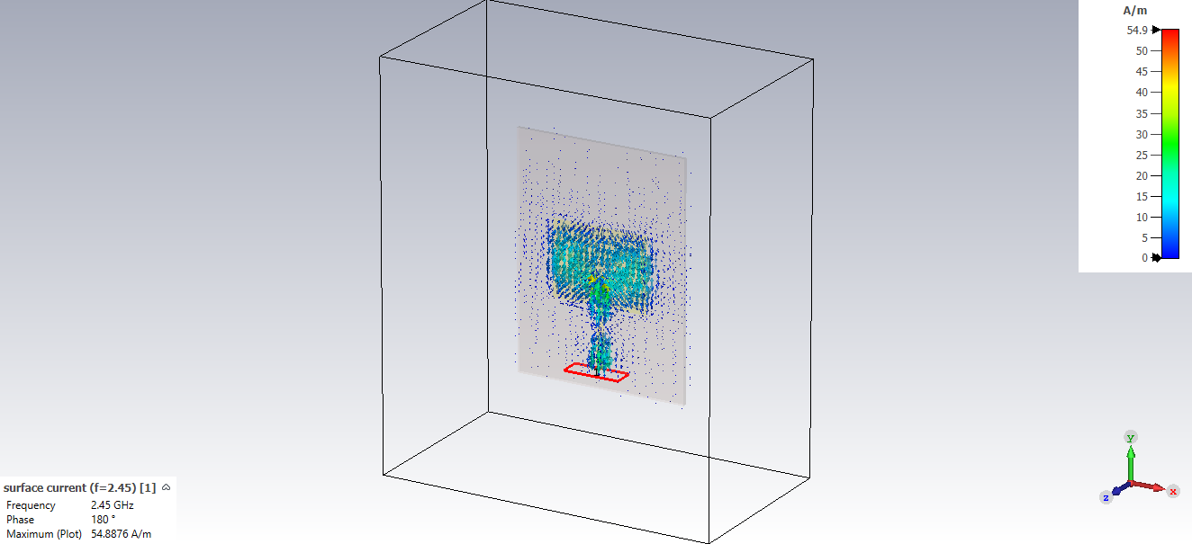
Current distribution – Antenna only
Phase: 90°
Maximum value: 54.8876 A/m
Phase: 180°
Maximum value: 54.8876 A/m

Slide 16
Electric and Magnetic fields

Slide 17
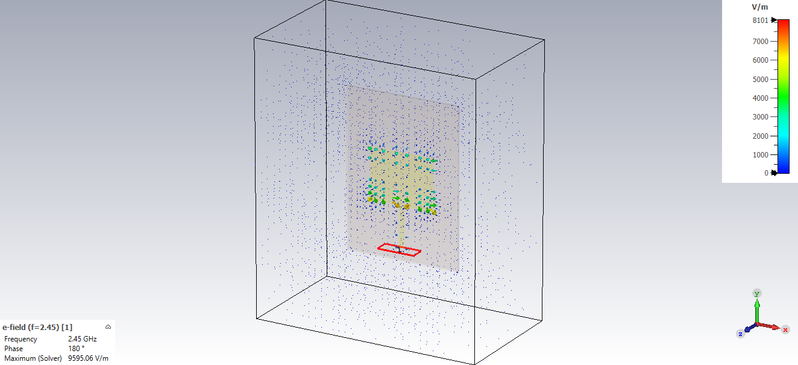

E/H Fields – Antenna only
E-field
Maximum value: 9595.06 V/m
H-field
Maximum value: 67.6191 A/m

Slide 18
CST modeling of the patch antenna Antenna and breast without cancerous mass

Slide 19
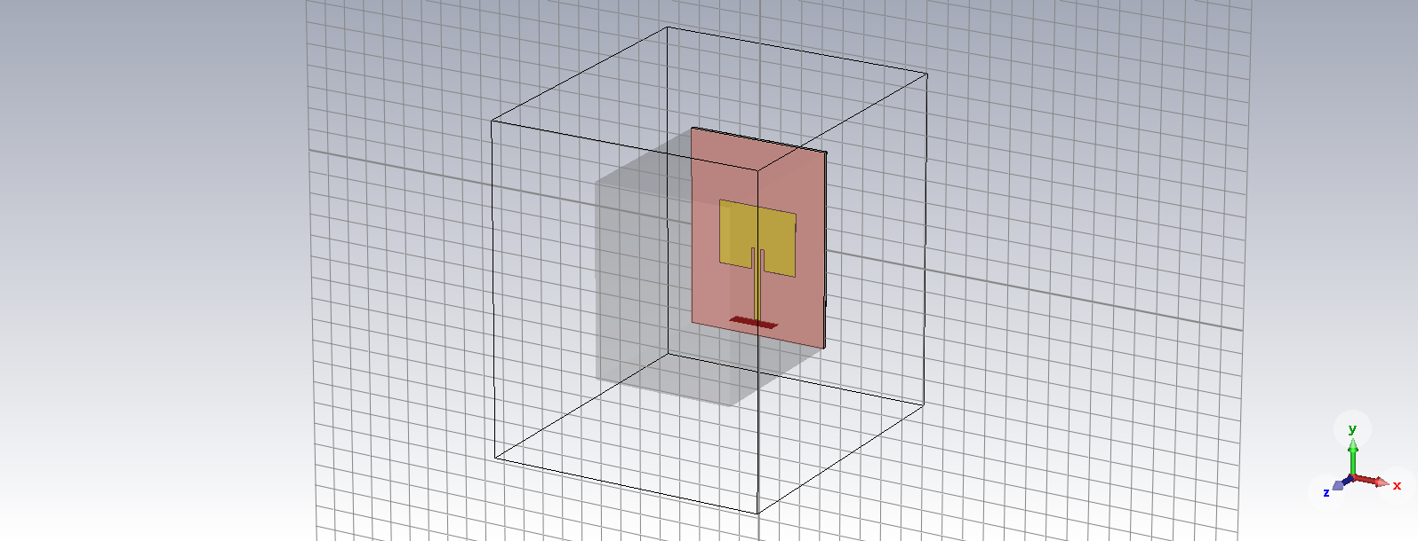
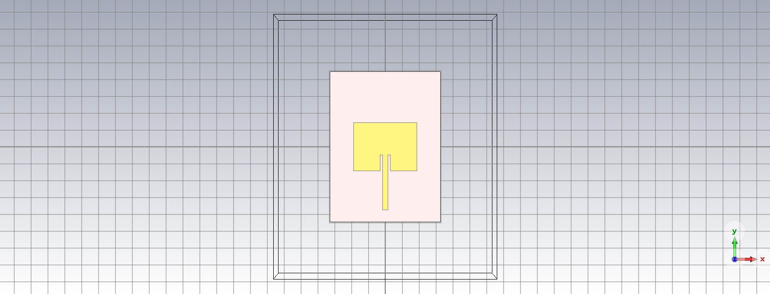
3D representation of the antenna and the breast
Perspective view
Front view

Slide 20
Dielectric and conductivity values of breast tissue
Tissue type | Dielectric (ε) | Conductivity (σ) [S/m] | Density [kg/m³]
Normal breast tissue | 9 | 0.4 | 978
Breast skin | 36 | 36.4 | 1020
Cancerous breast skin | 50 | 4 | 1100

Slide 21
Scattering Parameters (S₁₁)

Slide 22
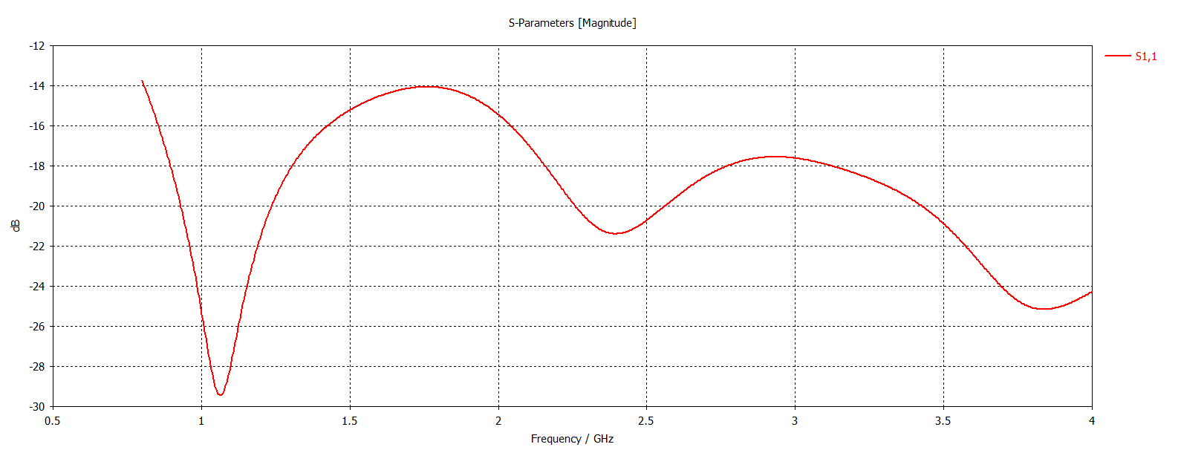
S₁₁ – Antenna and breast

Slide 23
VSWR (Voltage Standing-Wave Ratio)

Slide 24
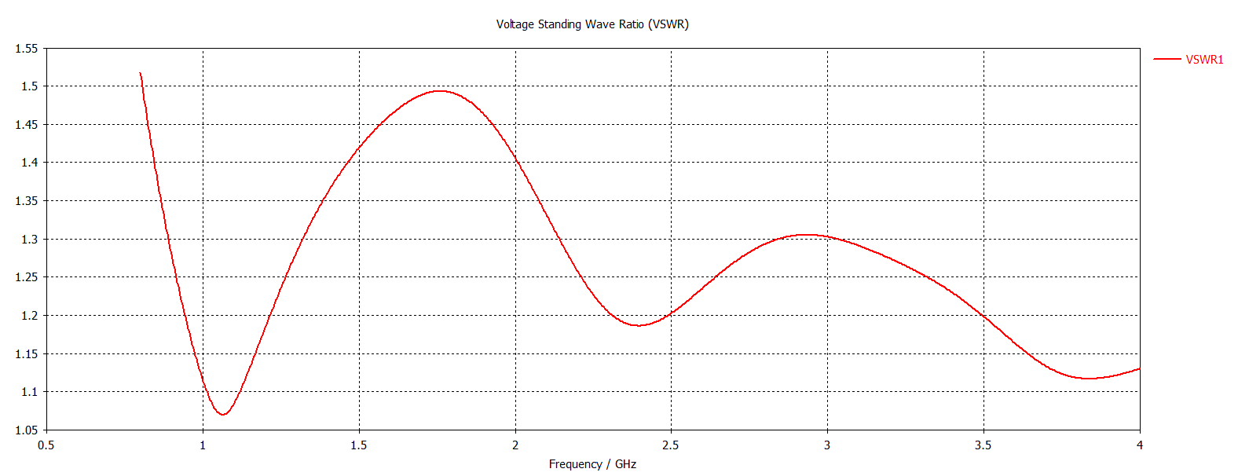
VSWR – Antenna and breast

Slide 25
Directivity (3-dimensional pattern, Azimuthal plane, Elevation plane)

Slide 26
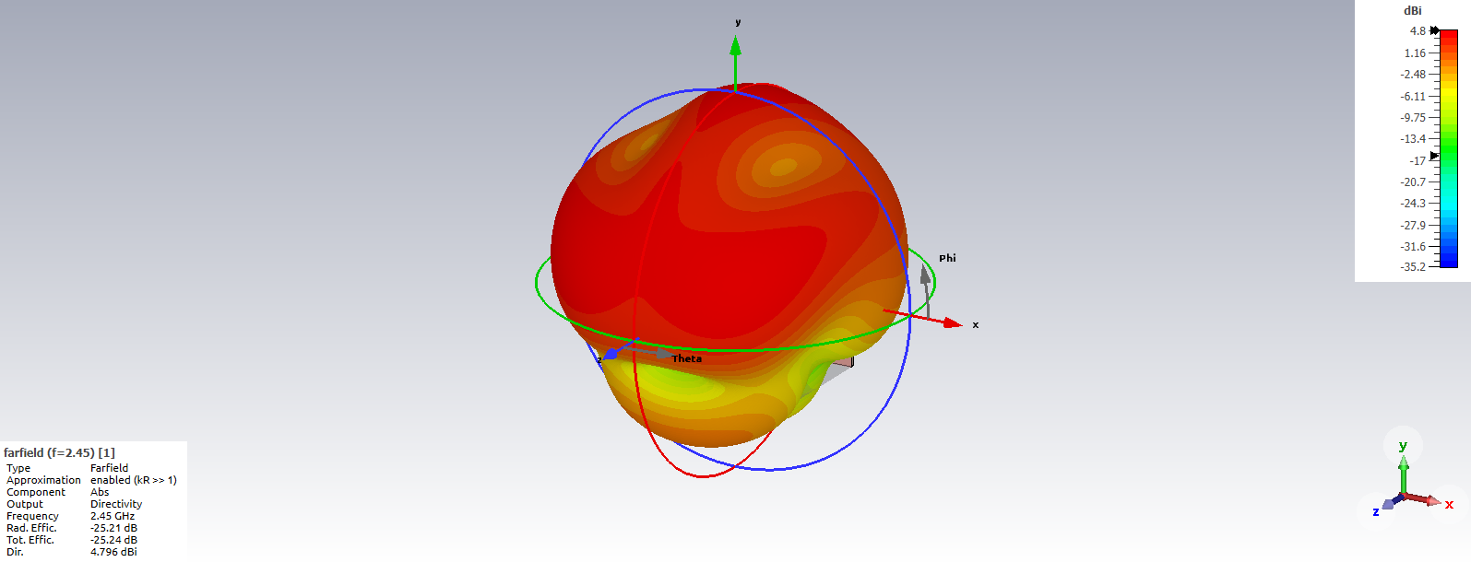
Directivity – Antenna and breast
3-dimensional representation of the emissions of the antenna

Slide 27
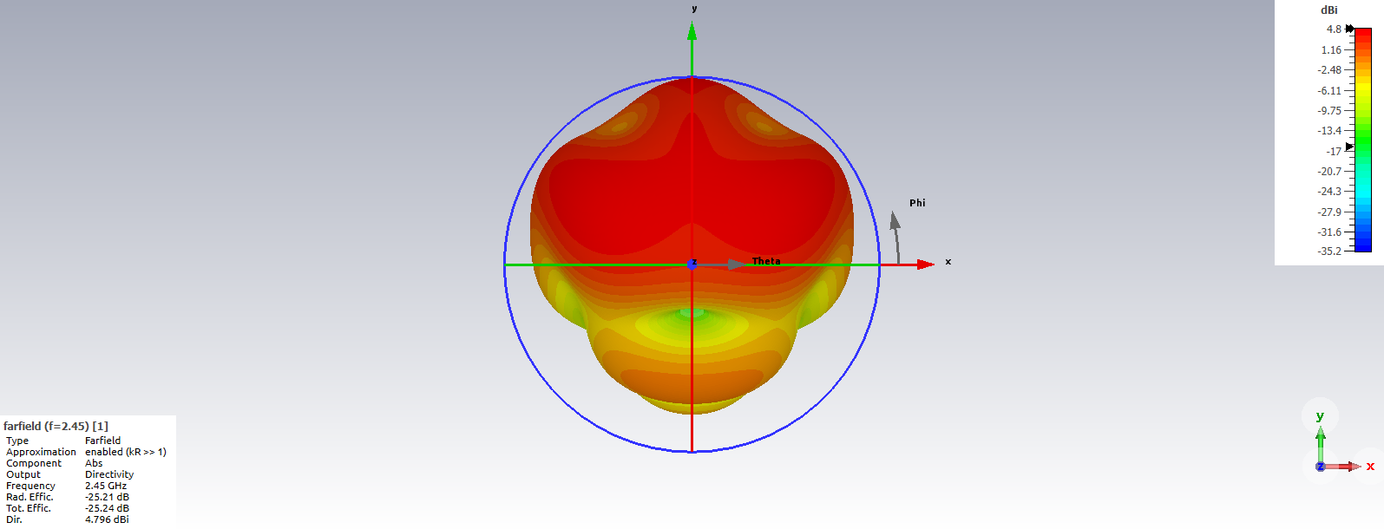
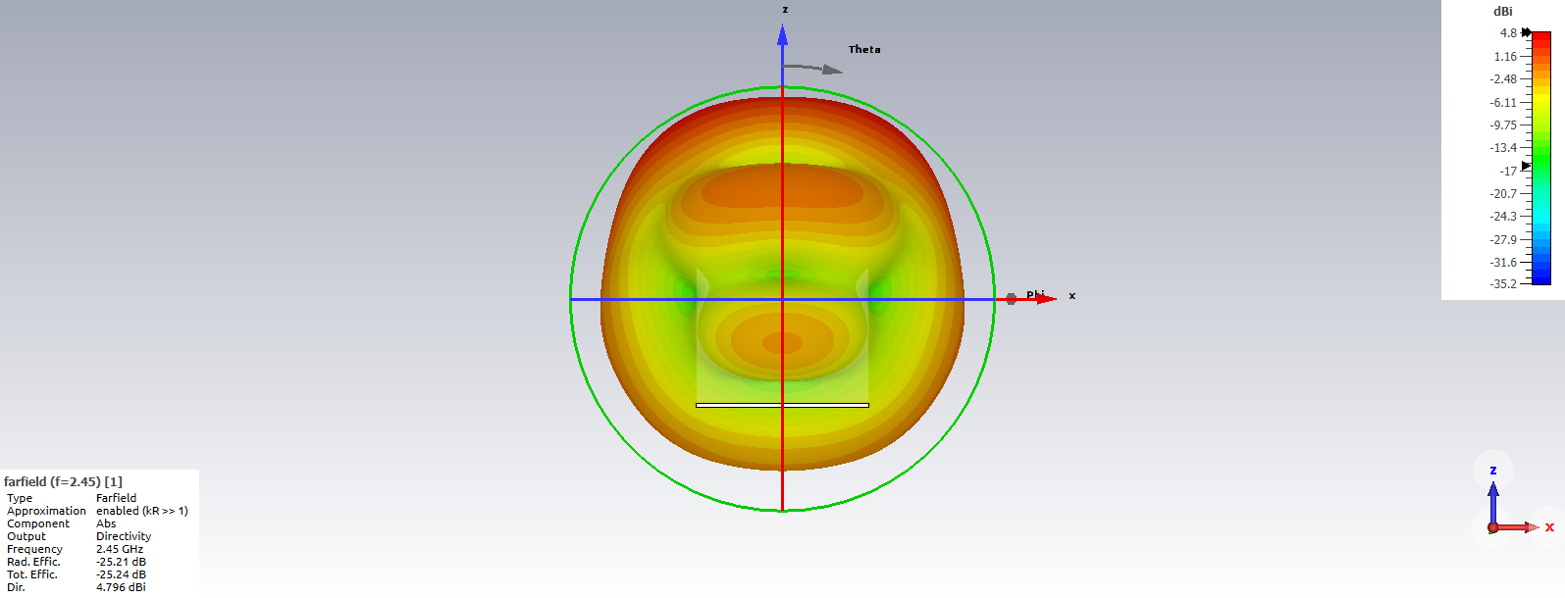
Directivity – Antenna and breast
Azimuth plane
Elevation plane

Slide 28
Current distribution

Slide 29
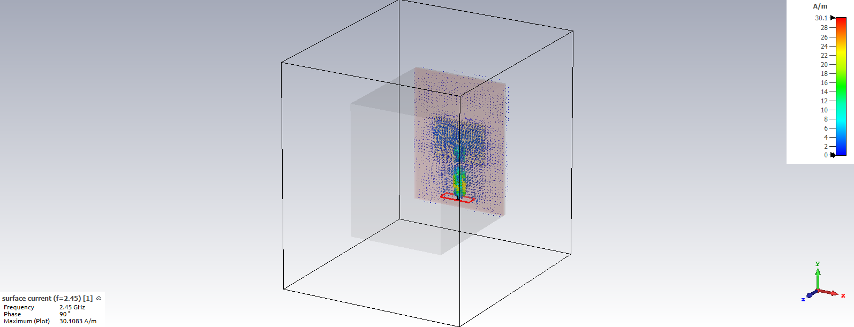
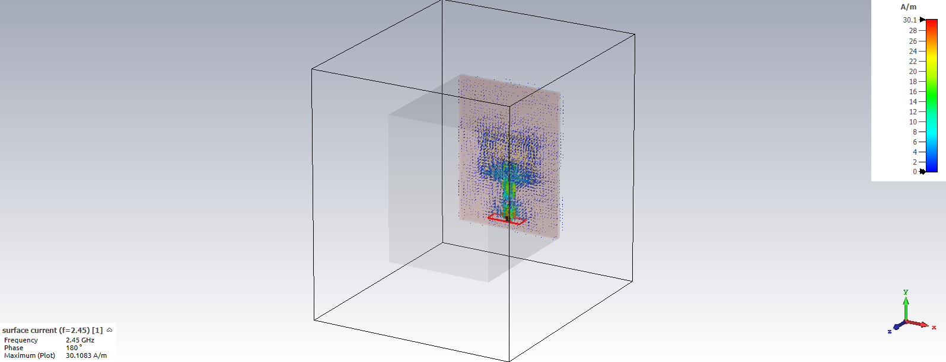
Current distribution – Antenna and breast
Phase: 90°
Maximum value: 30.1083 A/m
Phase: 180°
Maximum value: 30.1083 A/m

Slide 30
Electric and Magnetic fields

Slide 31
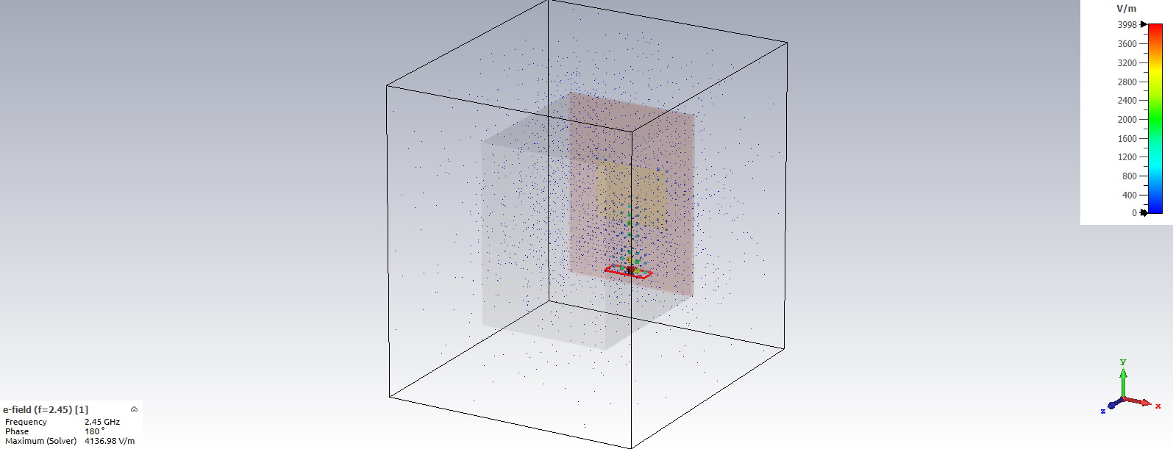

E/H Fields – Antenna and breast
E-field
Maximum value: 4136.98 V/m
H-field
Maximum value: 42.2117 A/m

Slide 32
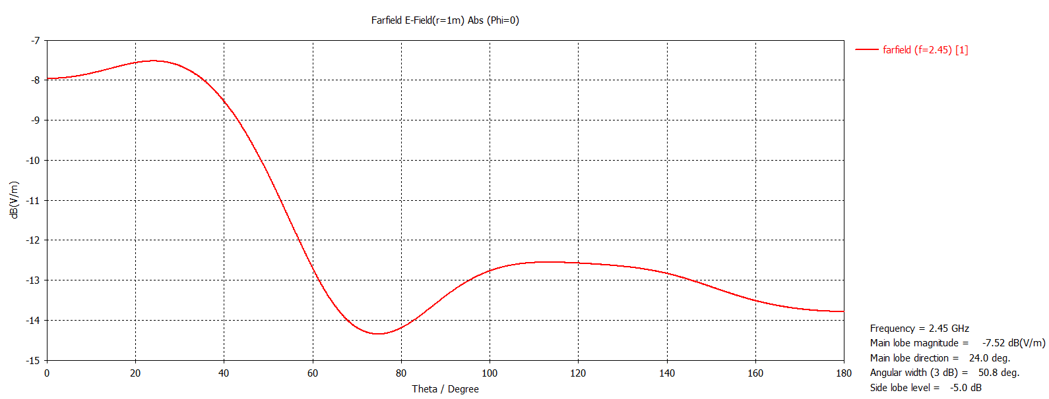
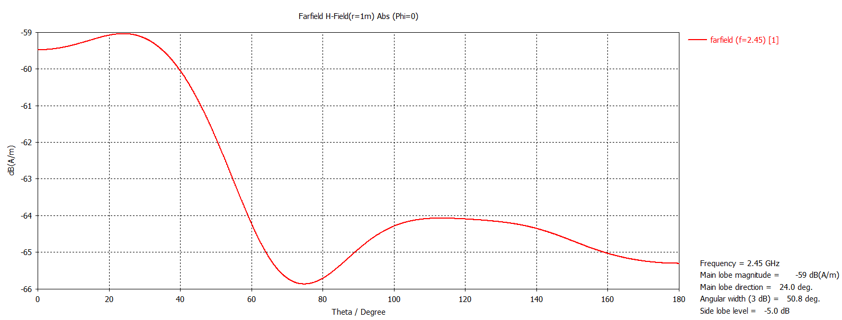
1-Dimensional E/H-Fields
E-Field
H-Field

Slide 33
CST modeling of the patch antenna Antenna and breast with cancerous mass

Slide 34
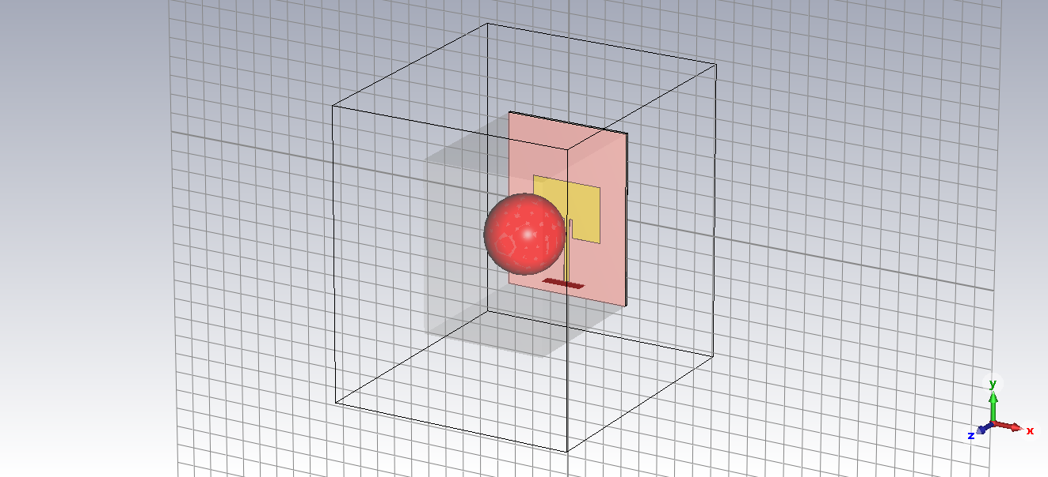
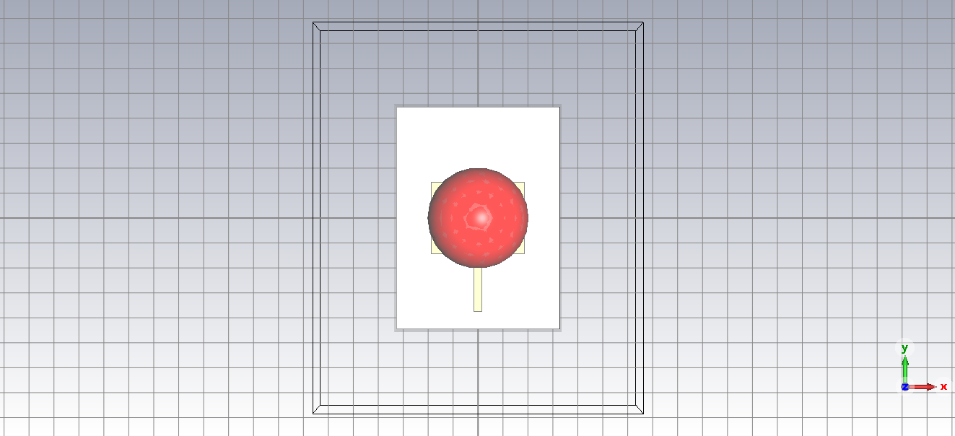
3D representation of antenna, breast, and cancer
Perspective view
Front view

Slide 35
Scattering Parameters (S₁₁)

Slide 36
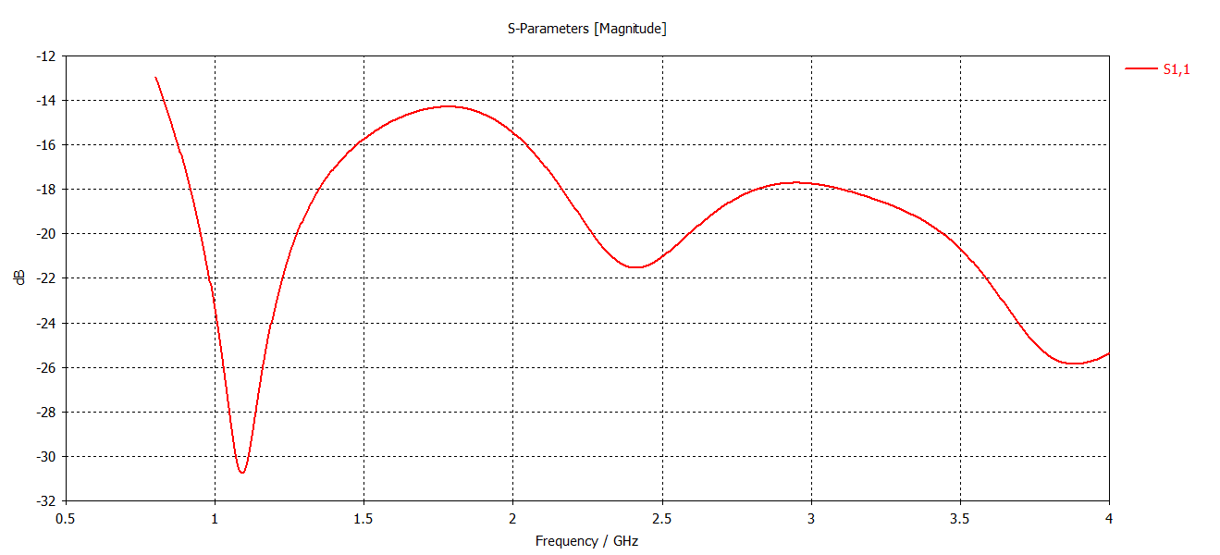
S₁₁ – Antenna, breast, and cancer

Slide 37
VSWR (Voltage Standing-Wave Ratio)

Slide 38
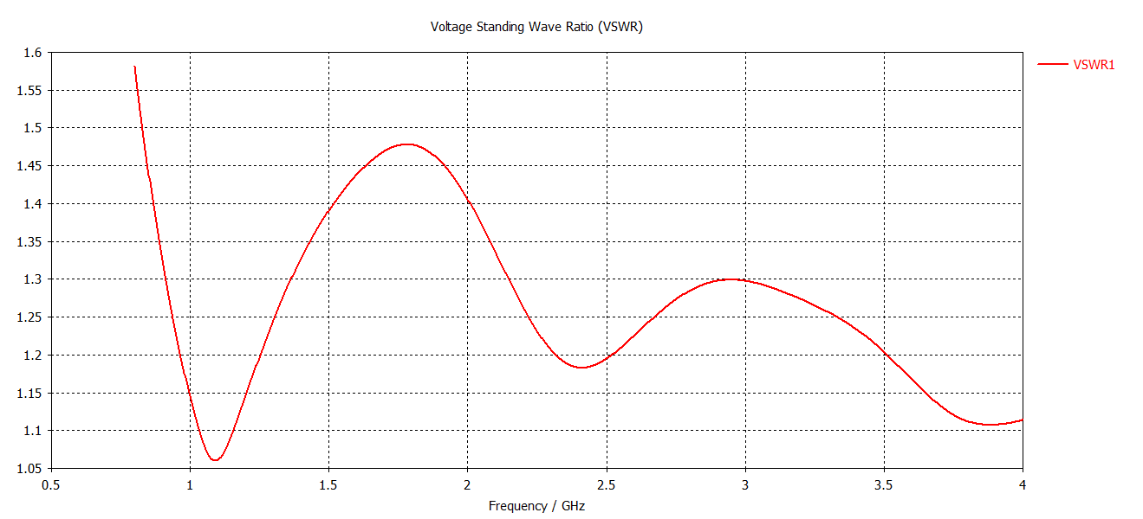
VSWR – Antenna, breast, and cancer

Slide 39
Directivity (3-dimensional pattern, Azimuthal plane, Elevation plane)

Slide 40
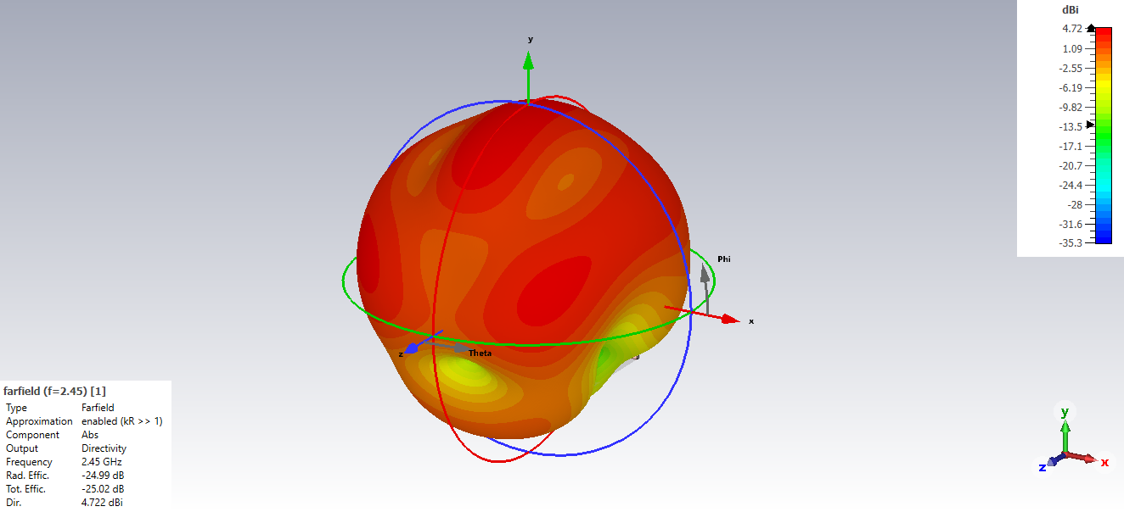
Directivity – Antenna, breast, and cancer
3-dimensional representation of the emissions of the antenna

Slide 41
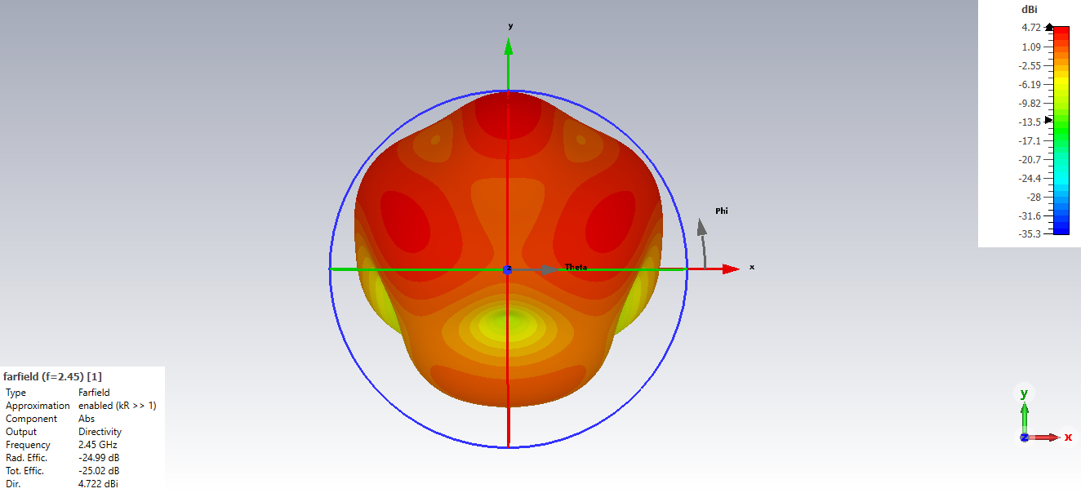
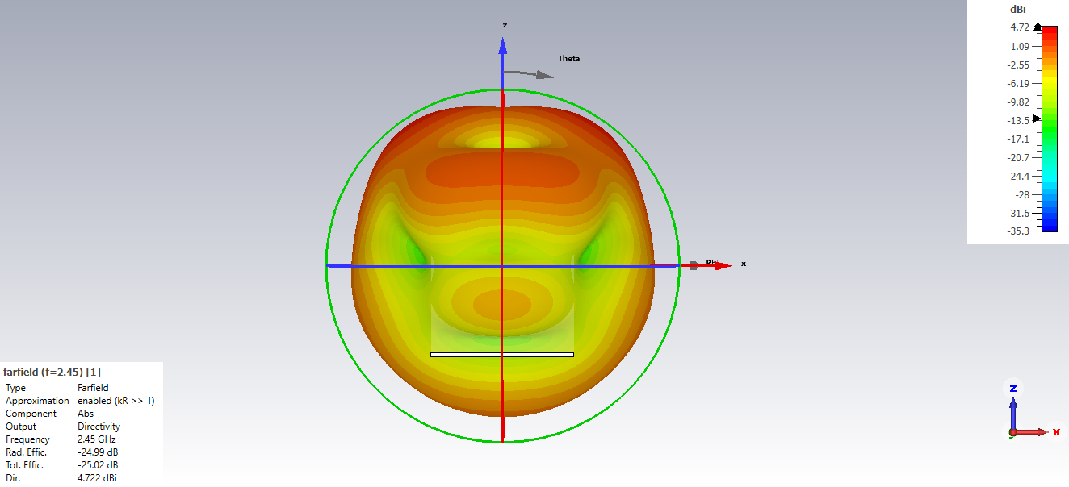
Directivity – Antenna, breast, and cancer
Azimuth plane
Elevation plane

Slide 42
Current distribution

Slide 43
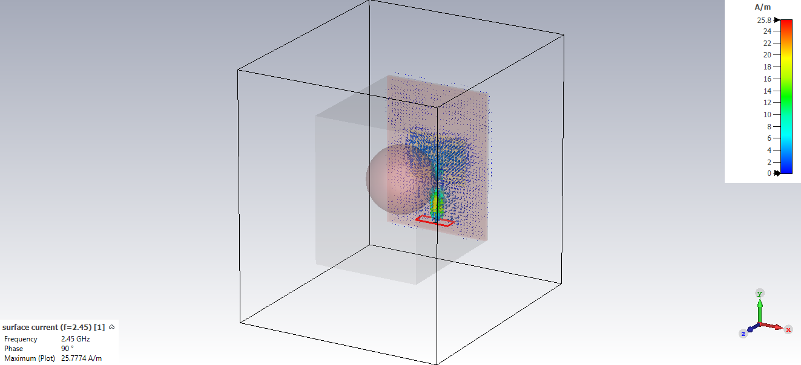
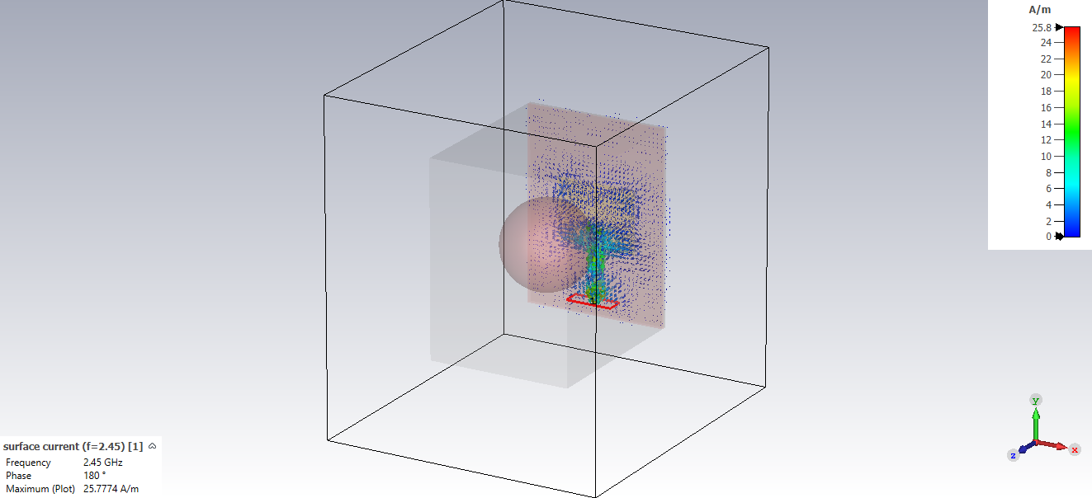
Current distribution – Antenna, breast, and cancer
Phase: 90°
Phase: 180°

Slide 44
Electric and Magnetic fields

Slide 45
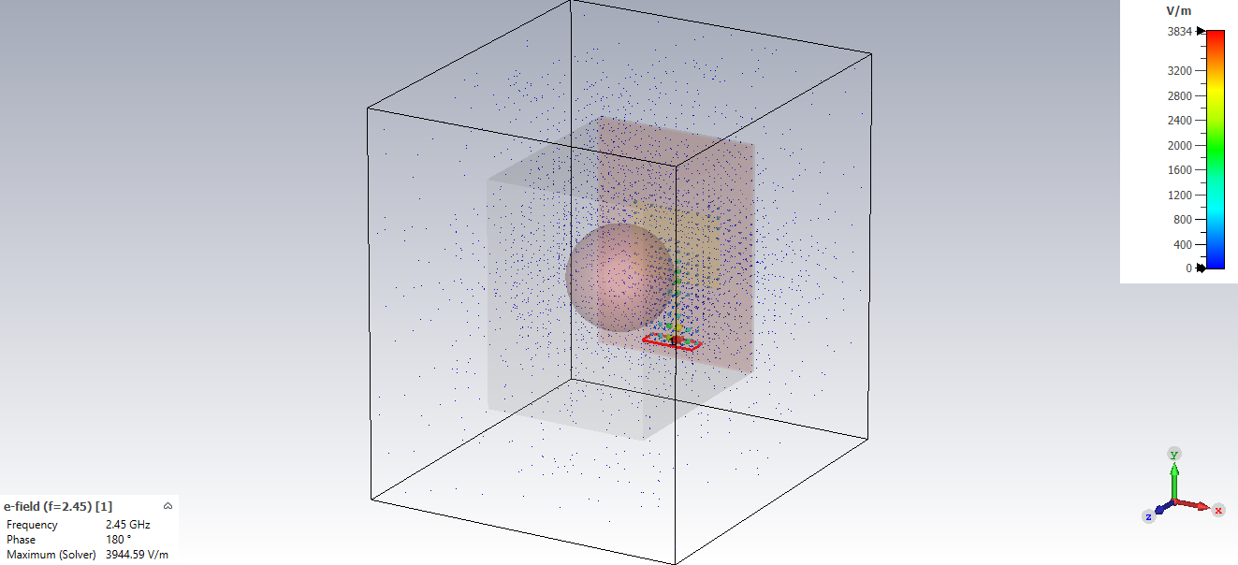
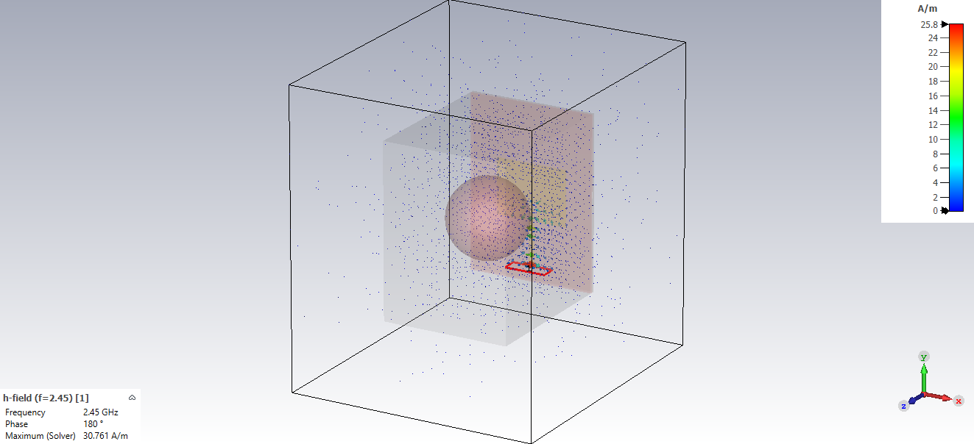
E/H Fields – Antenna, breast, and cancer
E-field
Maximum value: 3944.59 V/m
H-field
Maximum value: 30.761 A/m

Slide 46
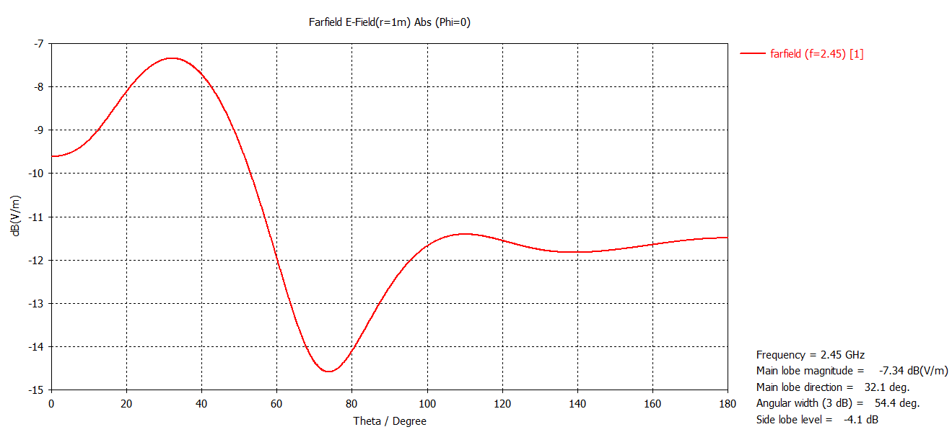
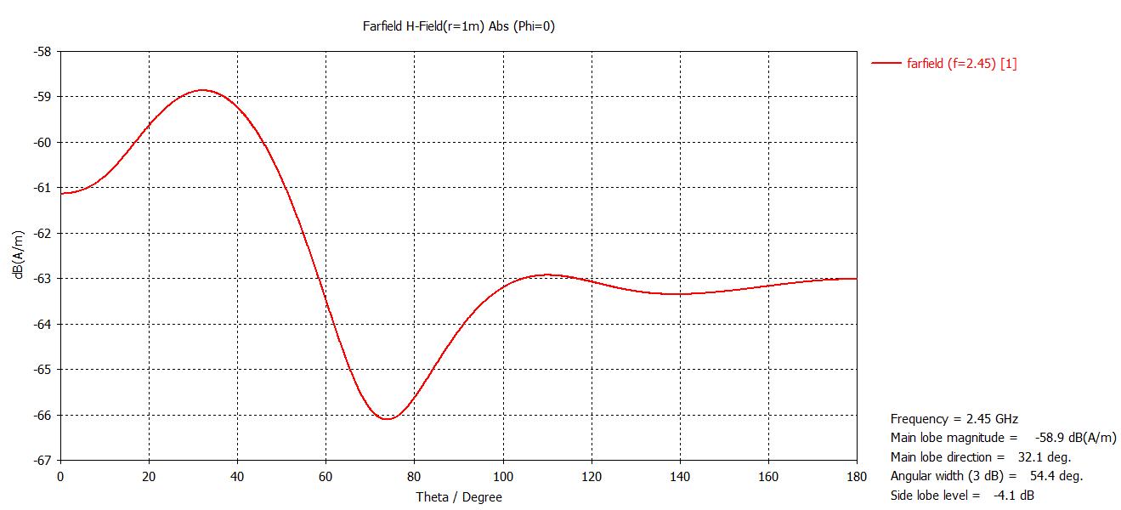
1-Dimensional E/H-Fields
E-Field
H-Field

Slide 47
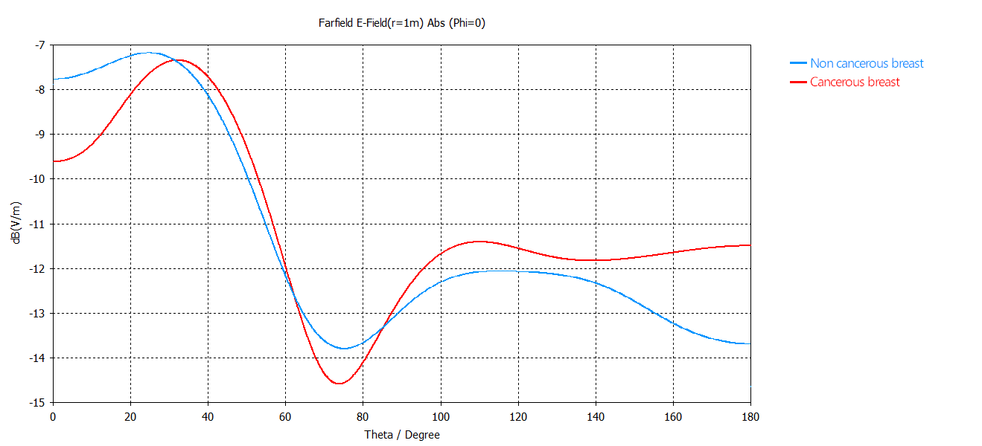
Comparison of the E-Field with and without cancer

Slide 48
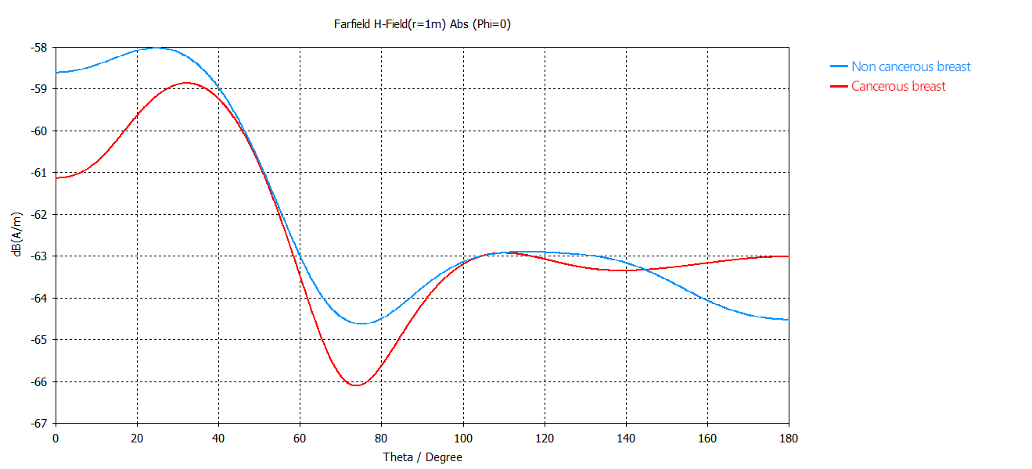
Comparison of the H-Field with and without cancer

Slide 49
Parameter sweep Modified patch dimensions

Slide 50
Parameter sweep details
Name | Set 1 | Set 2 | Set 3 | Set 4 | Set 5 | Set 6 | Set 7 | Set 8 | Set 9
p_x [mm] | 27.26 | 27.26 | 27.26 | 37.26 | 37.26 | 37.26 | 47.26 | 47.26 | 47.26
p_y [mm] | 18.83 | 28.83 | 38.83 | 18.83 | 28.83 | 38.83 | 18.83 | 28.83 | 38.83

Slide 51
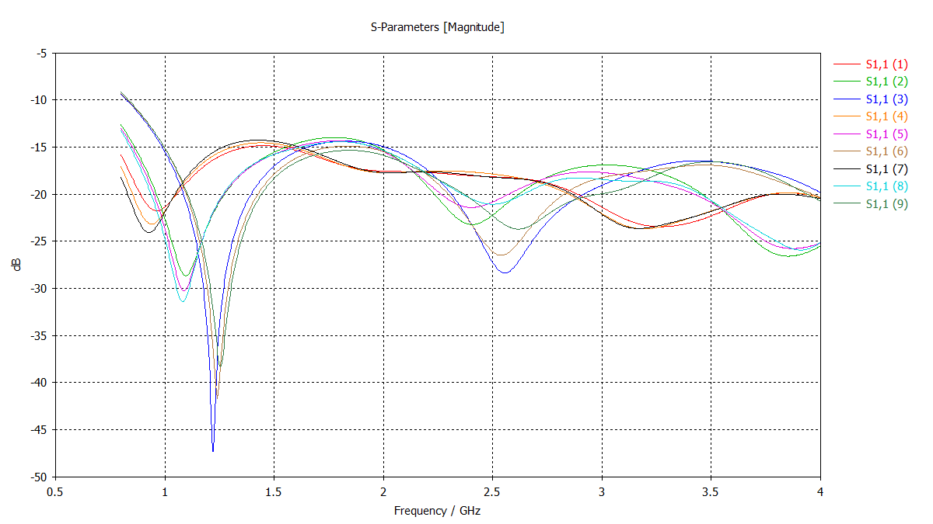
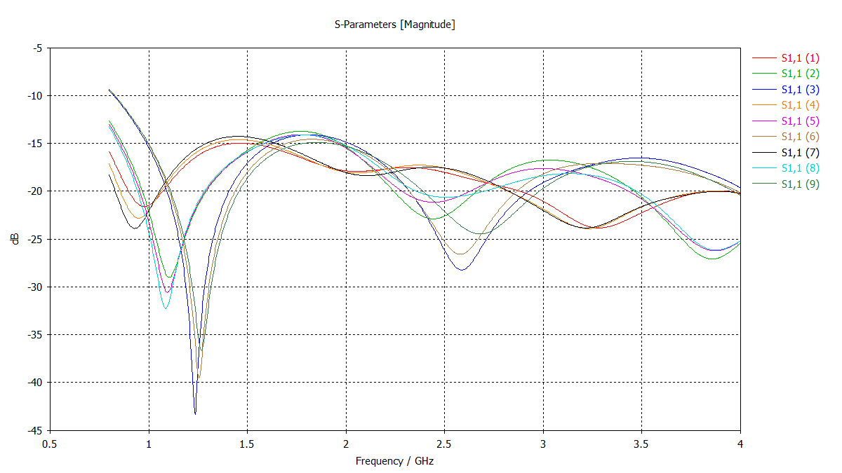
Comparison: S₁₁ with and without cancer
S₁₁ parameters – healthy tissue
S₁₁ parameters – cancerous tissue

Slide 52
Selecting the best parameters
Parameter set | Healthy tissue [dB] | Cancerous tissue [dB] | Difference [dB]
1 | -21.77 | -21.61 | -0.16
2 | -28.63 | -29.01 | 0.38
3 | -47.34 | -43.37 | -3.97
4 | -23.18 | -22.83 | -0.35
5 | -30.28 | -30.56 | 0.28
6 | -41.66 | -39.55 | -2.11
7 | -24.07 | -23.89 | -0.18
8 | -31.44 | -32.26 | 0.82
9 | -38.21 | -36.69 | -1.52

Slide 53
Other antenna designs

Slide 54
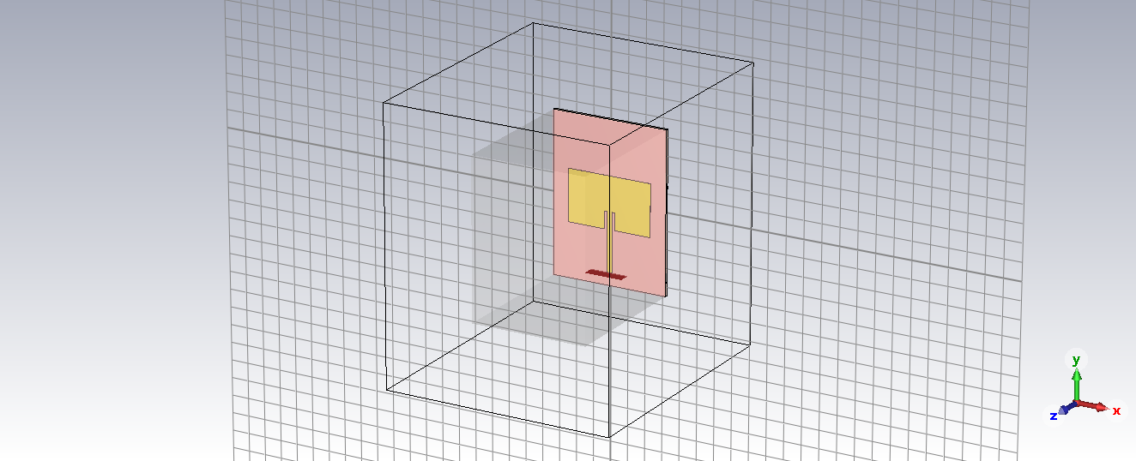
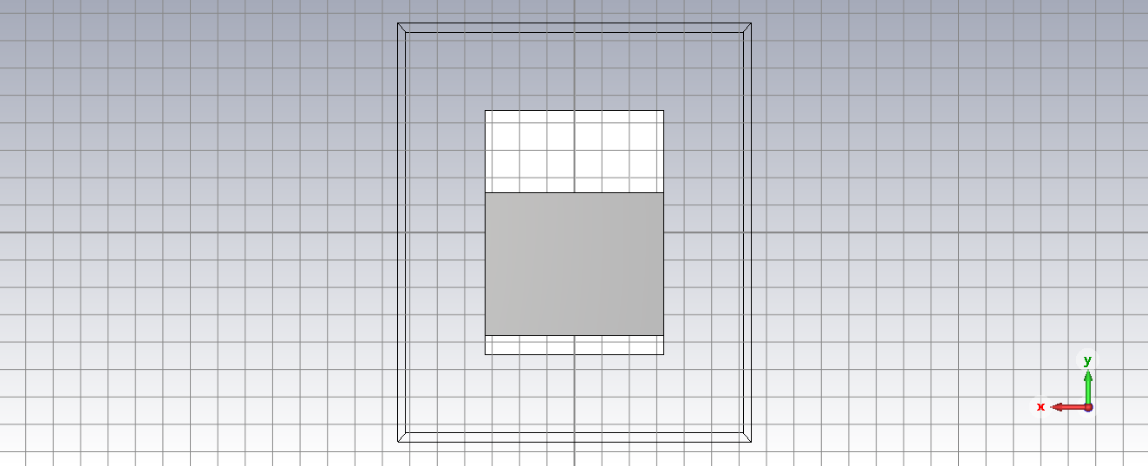
1st alternative design: modified ground plane
Perspective view
Default parameters
Back view
Default parameters

Slide 55
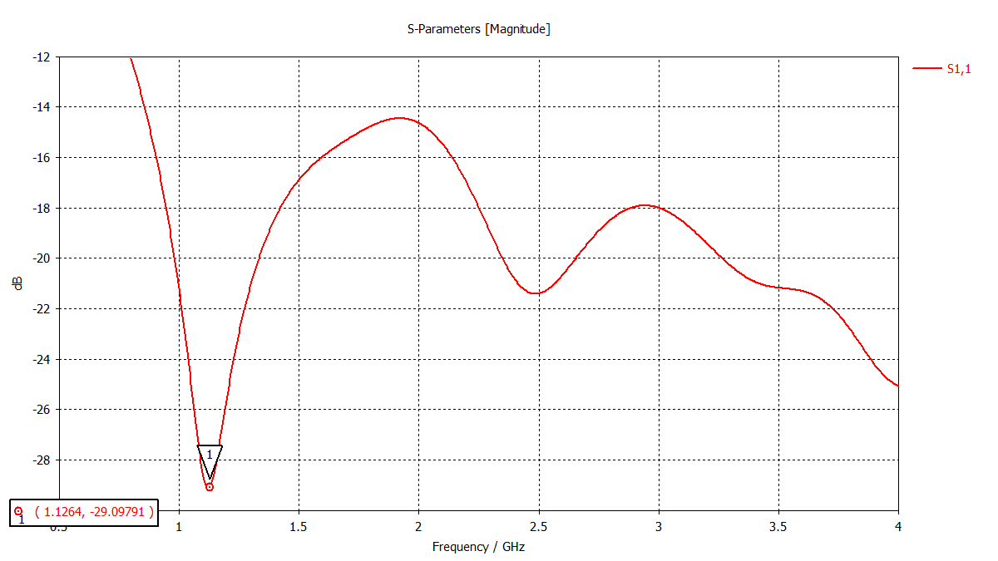
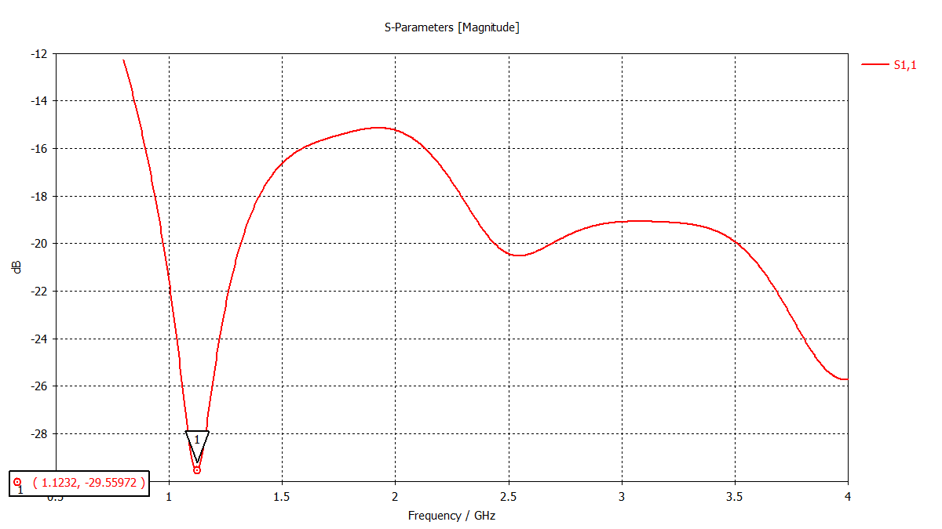
1st alternative design: modified ground plane
S₁₁ parameters – healthy breast
Default parameters
S₁₁ parameters – cancerous breast
Default parameters
Difference: 0.46 dB

Slide 56
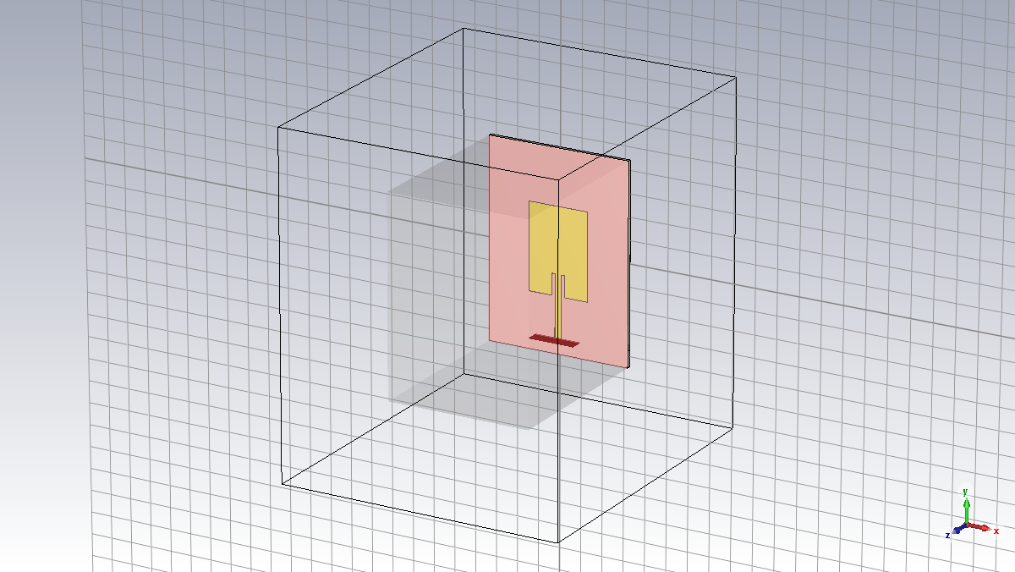
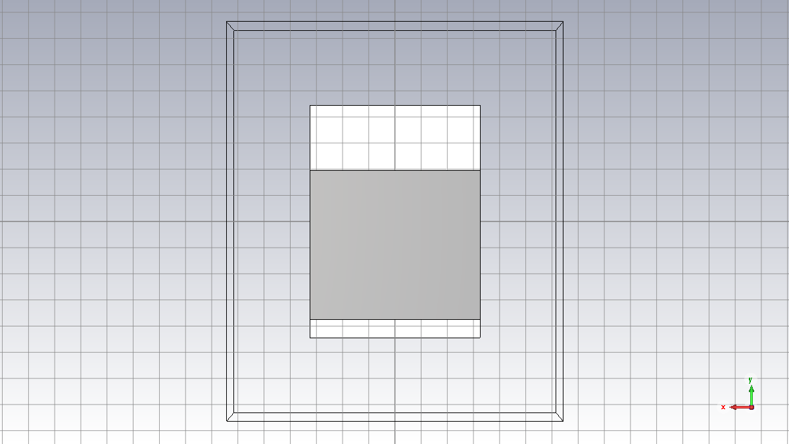
1st alternative design: modified ground plane
Perspective view
Optimized parameters
Back view
Optimized parameters

Slide 57
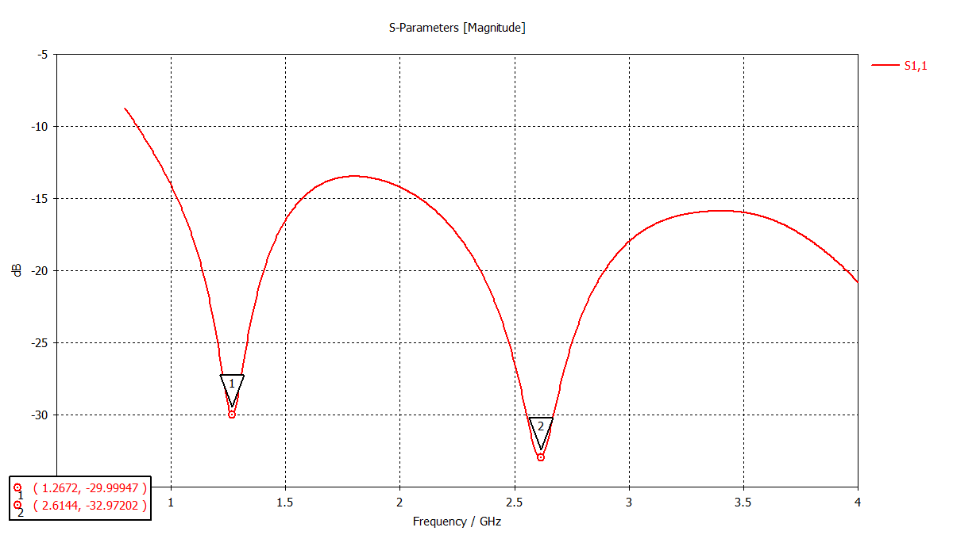
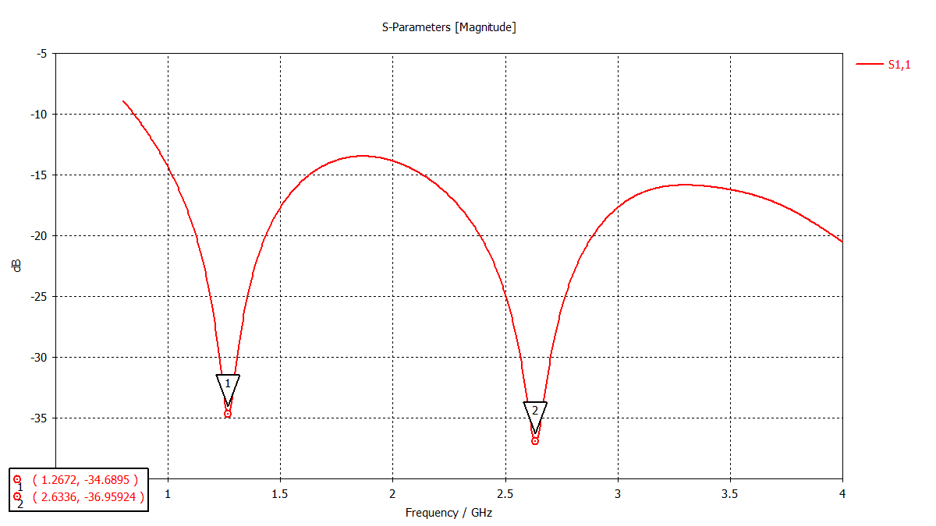
1st alternative design: modified ground plane
S₁₁ parameters – healthy breast
Optimized parameters
S₁₁ parameters – cancerous breast
Optimized parameters
Difference: [1] 4.69 dB, [2] 3.99 dB

Slide 58
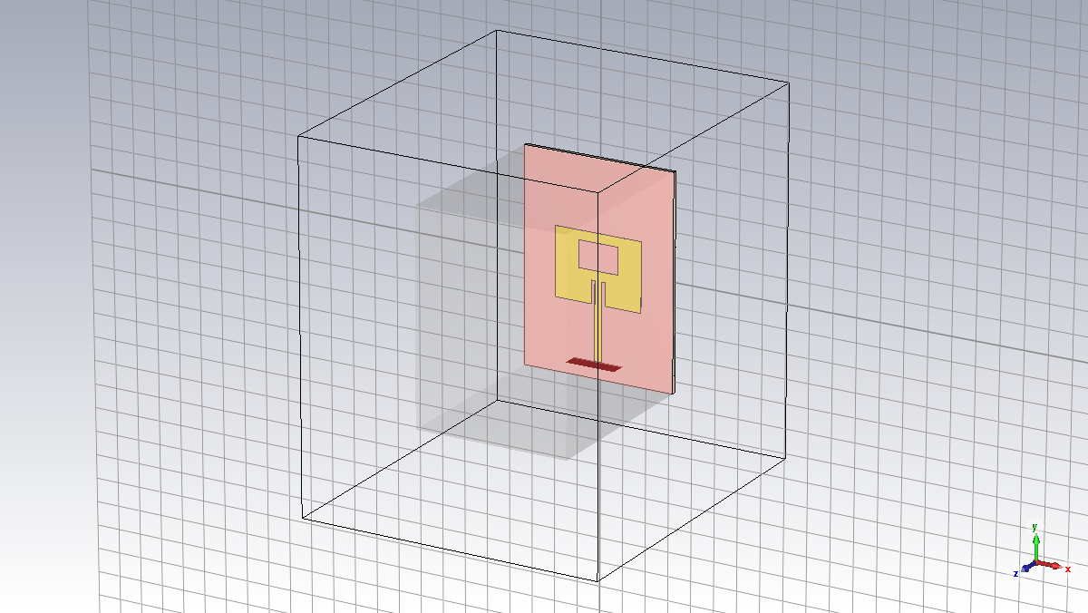
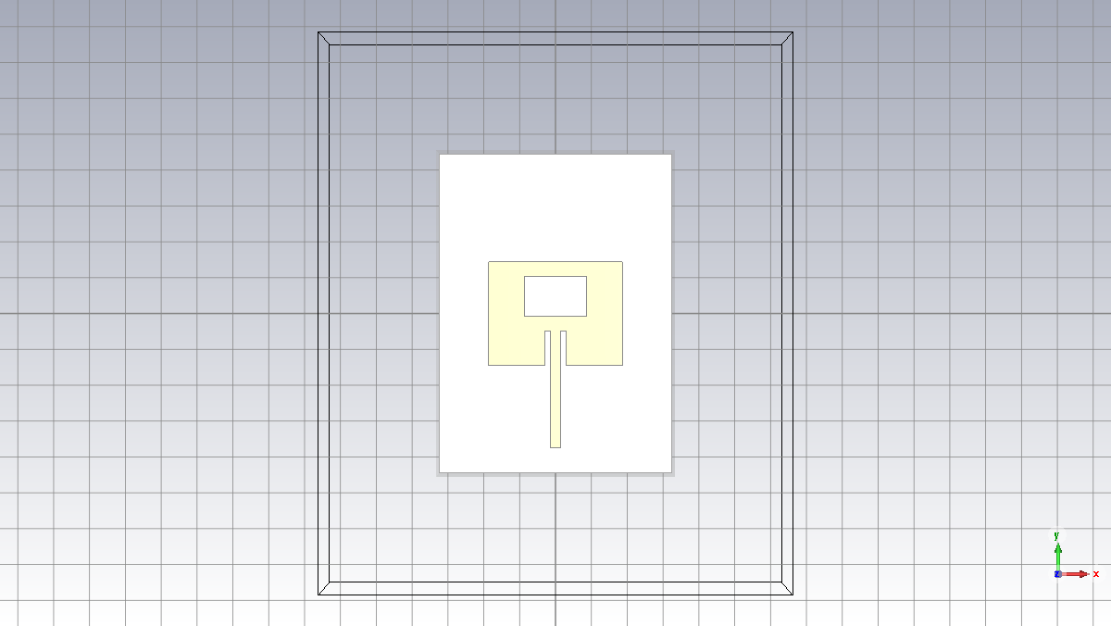
2nd alternative design: big slot, modified ground
Perspective view
Default parameters
Front view
Default parameters

Slide 59


2nd alternative design: big slot, modified ground
S₁₁ parameters – healthy breast
Default parameters
S₁₁ parameters – cancerous breast
Default parameters
Difference: 0.44 dB

Slide 60


2nd alternative design: big slot, modified ground
Perspective view
Optimized parameters
Front view
Optimized parameters

Slide 61


2nd alternative design: big slot, modified ground
S₁₁ parameters – healthy breast
Optimized parameters
S₁₁ parameters – cancerous breast
Optimized parameters
Difference: 5.32 dB

Slide 62


3rd alternative design: thin slot, modified ground
Perspective view
Default parameters
Front view
Default parameters

Slide 63


3rd alternative design: thin slot, modified ground
S₁₁ parameters – healthy breast
Default parameters
S₁₁ parameters – cancerous breast
Default parameters
Difference: 0.59 dB

Slide 64


3rd alternative design: thin slot, modified ground
Perspective view
Optimized parameters
Front view
Optimized parameters

Slide 65


3rd alternative design: thin slot, modified ground
S₁₁ parameters – healthy breast
Optimized parameters
S₁₁ parameters – cancerous breast
Optimized parameters
Difference: 4.92 dB

Slide 66
Parameter sweep Modified cancer radius

Slide 67
Parameter sweep details
Name | Set 1 | Set 2 | Set 3 | Set 4 | Set 5 | Set 6 | Set 7 | Set 8 | Set 9 | Set 10 | Set 11
c_radius [mm] | 0.2 | 2 | 3.03 | 5.86 | 8 | 8.68 | 11.51 | 14 | 14.34 | 17.17 | 20

Slide 68


S₁₁ parameters
Entire plot
Zoom – Detailed view

Slide 69
SAR (Specific Absorption Rate)

Slide 70


SAR – Healthy tissue
SAR – 3D view
SAR – Back view
Maximum value: 33.57 W/kg; Total value: 0.95 W/kg

Slide 71


SAR – Cancerous tissue (20 mm)
SAR – 3D view
SAR – Back view
Maximum value: 33.33 W/kg; Total value: 0.66 W/kg

Slide 72


SAR – Cancerous tissue (2 mm)
SAR – 3D view
SAR – Back view
Maximum value: 33.47 W/kg; Total value: 0.67 W/kg

Slide 73
Conclusions

Slide 74
Obtained results
There is a certain difference between the E-fields or S-parameters in the healthy tissue compared to the cancerous tissue;
The difference observed is highlighted when the antenna dimensions are varied; the best parameters set is the third, where the patch is slightly higher than the original one;
By comparing the differences between the biggest dips in the S-parameters plots, the paper affirmed that the best antenna design was the one with a thin slot. This has been proven true, but only using the default parameters (difference of 0.59 dB): by using the optimized ones, the best design is the one with the big slot, which provides a significant increase in the difference (5.32 dB).

Slide 75
Obtained results
The best antenna design can detect a cancer sphere with a radius up to 0.2 mm;
The same antenna is safe to use, because its maximum total SAR is 0.95 W/kg.

